Slide 1


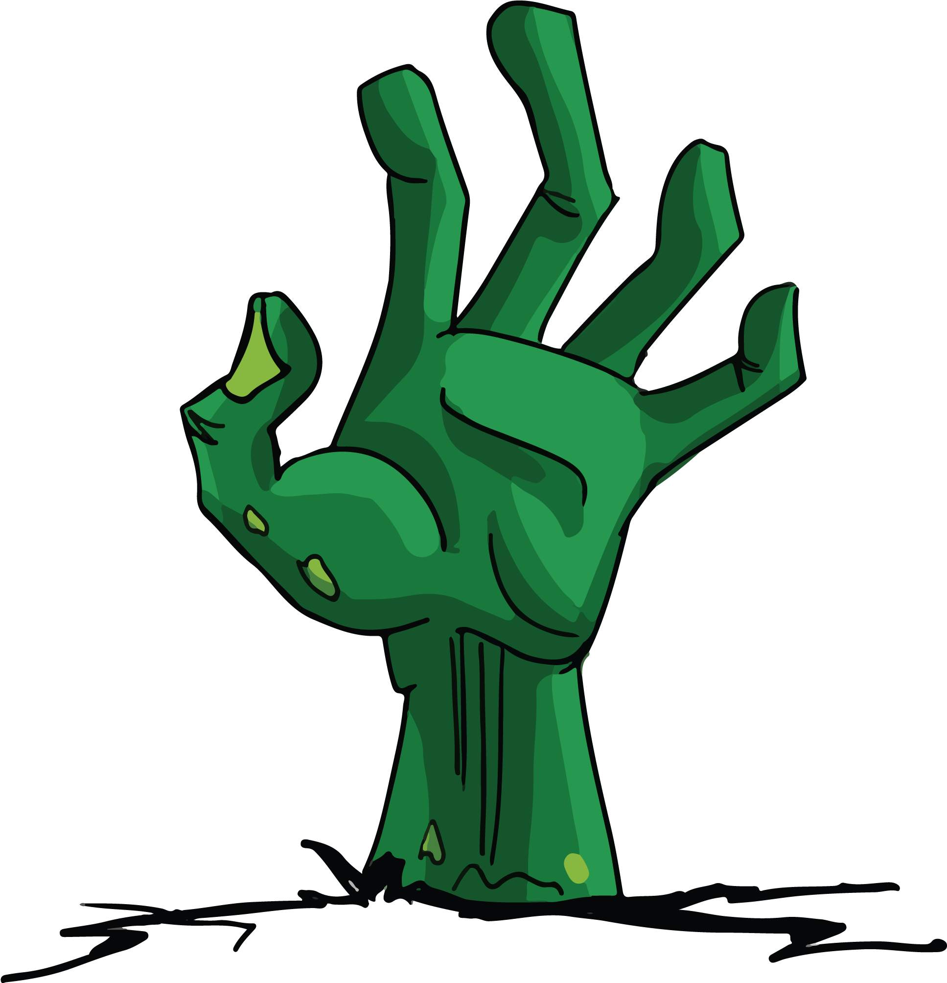
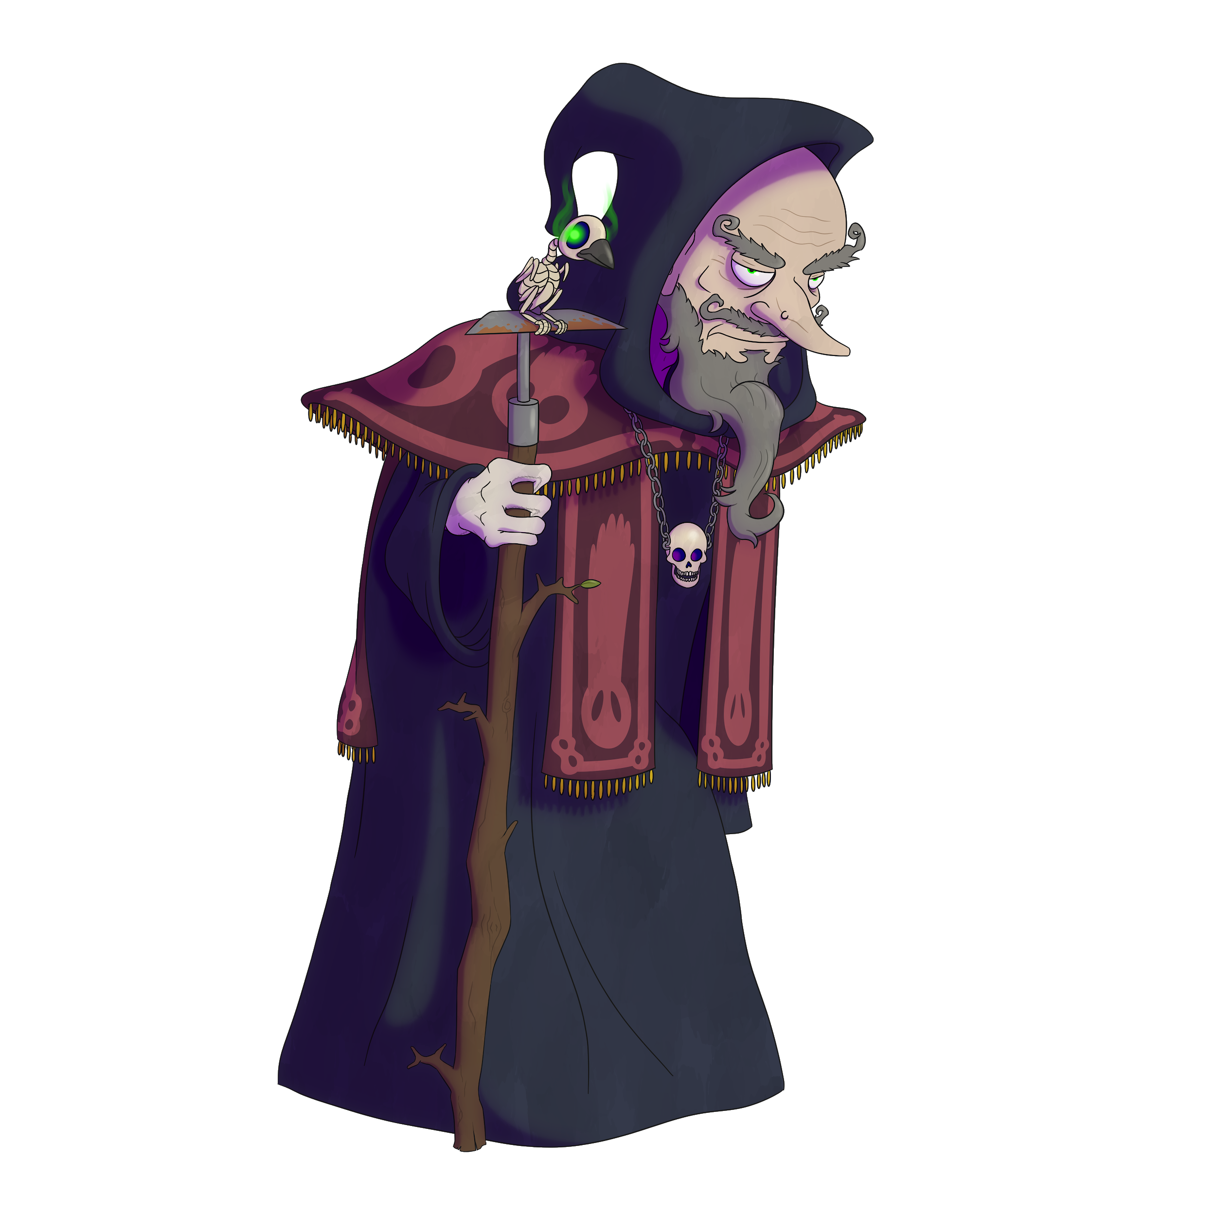
Necro Nursery
Team Abra-cadaver

Slide 2
Narrative
Finished fleshing out the Lich Character
Editing how much information to share within the game per character
Tested in game dialogue system
Got the world bible to a good stopping point for now.

Slide 3
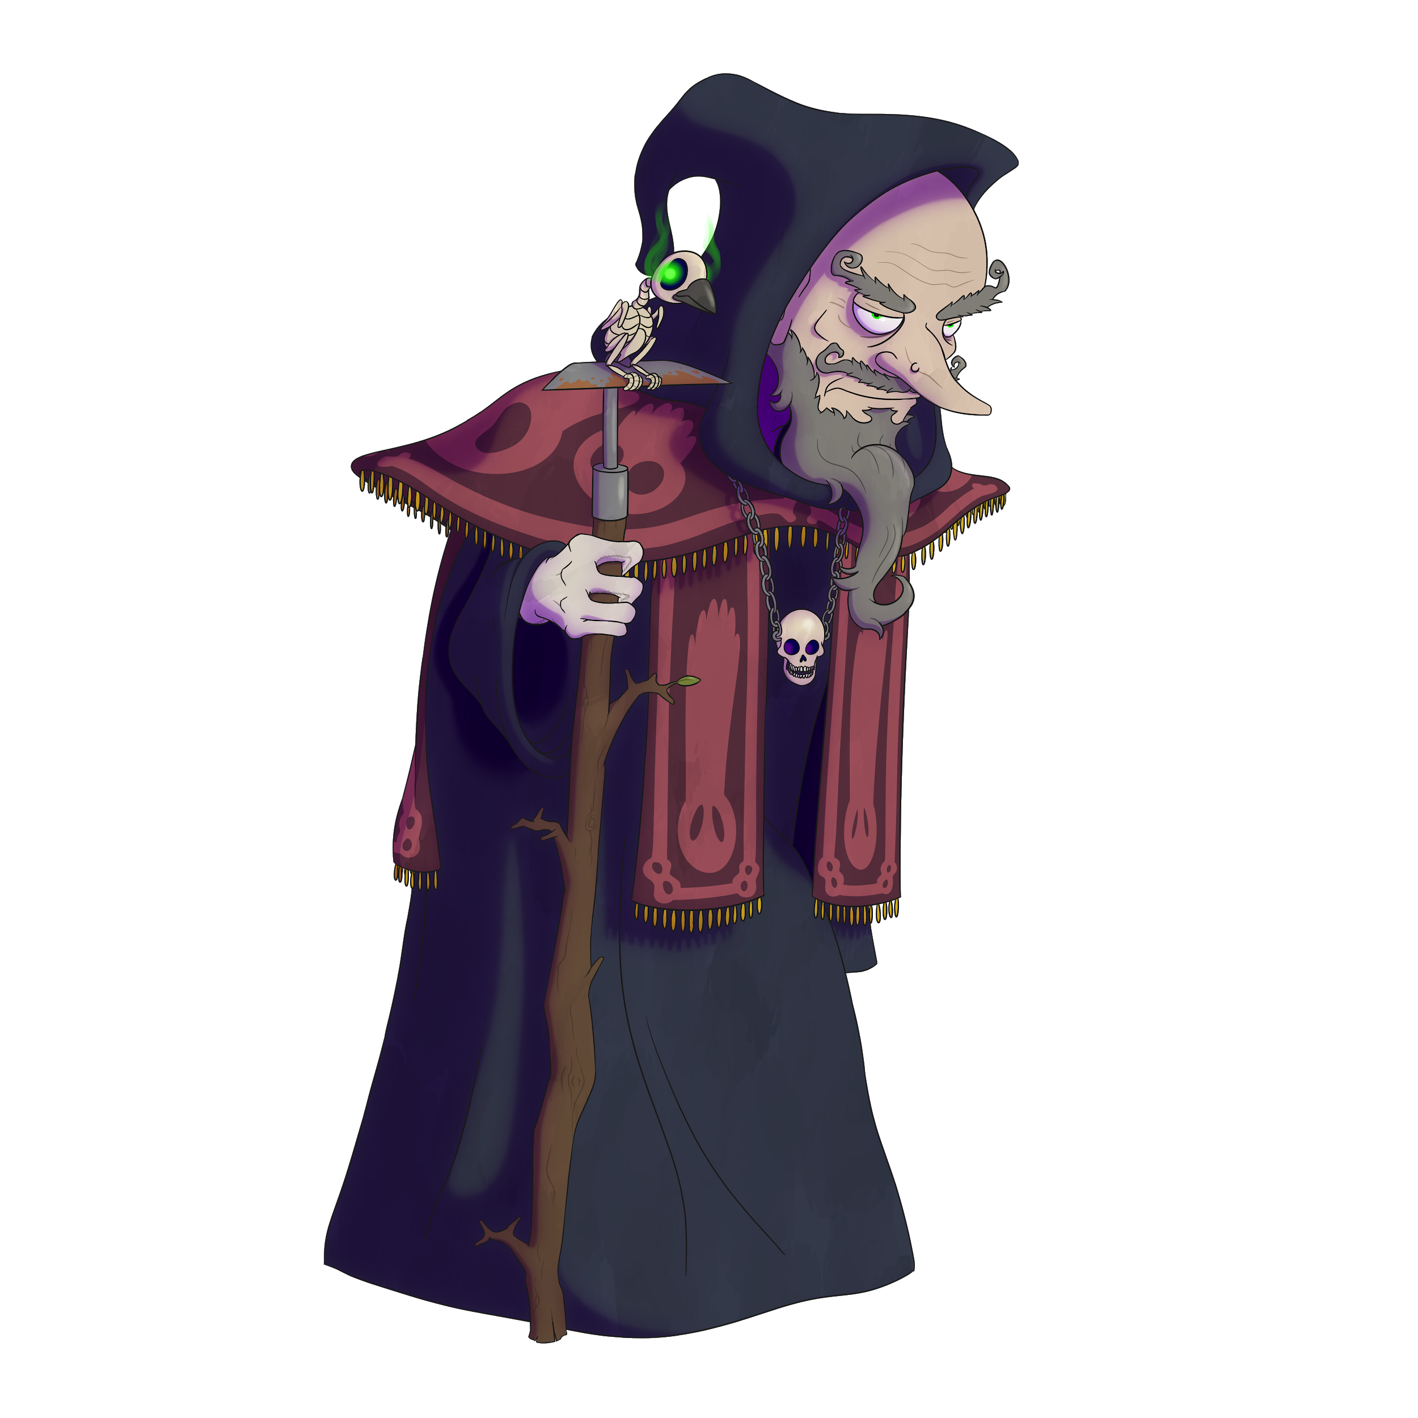
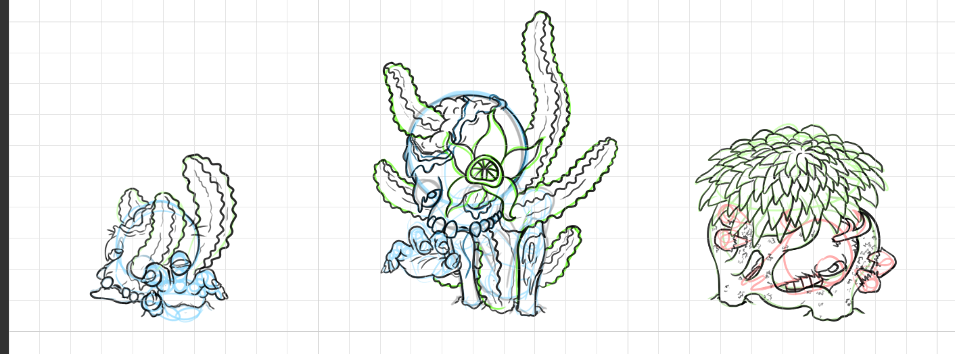

Slide 4
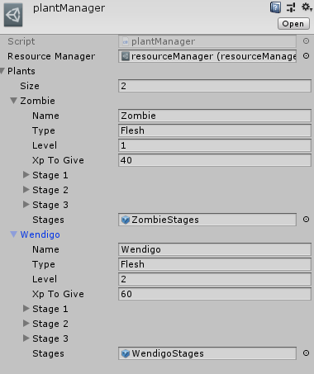
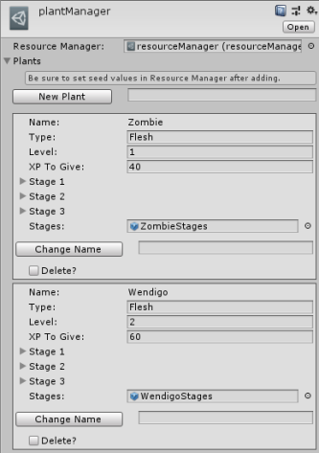
Programming
Mastermind win/lose conditions (finally)
Started list of prev. guesses.
Wrote a few Editor scripts to ease development later

Slide 5
Troubles along the way?
Sickness and Self care
Productivity

Slide 6
What we plan to do!
Feedback on backgrounds
Art assets for minigames
More general programming enhancements

Slide 7
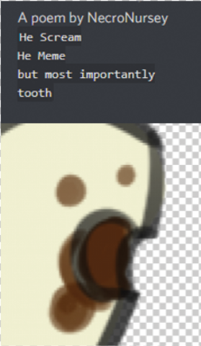
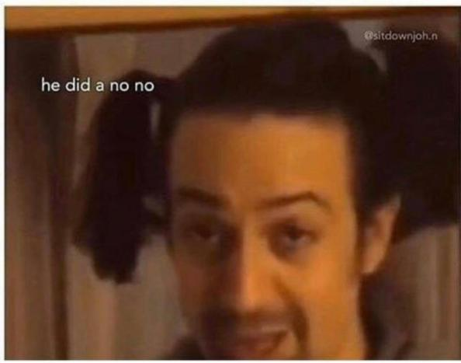
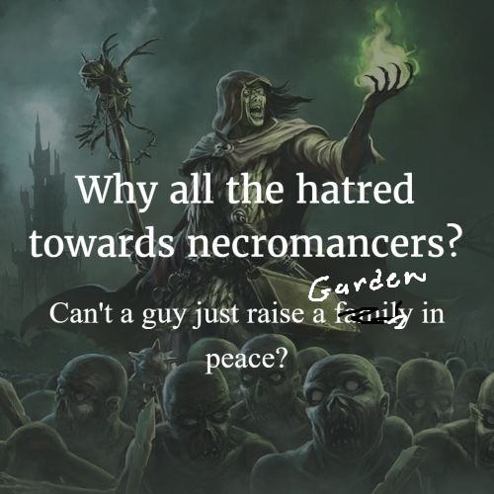

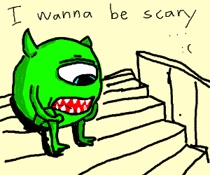
Questions?

